Slide 1


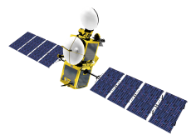

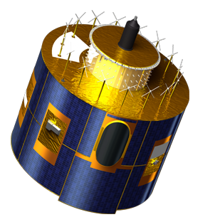
Data CeNtre Updates
GEO visit
02 July 2015

Slide 2

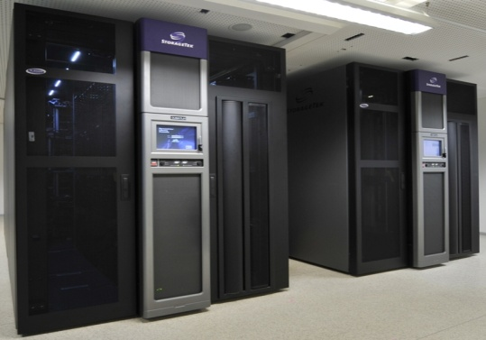

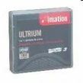

EUMETSAT Data Centre – Long Term Archive
EUMETSAT Geostationary Systems
Meteosat satellites
EUMETSAT Polar System
Metop satellites
Jason-2
Optional Programme
for Ocean Altimetry
SATELLITE APPLICATION
FACILITIES
within the Member States
Jason-2 facilities
http://www.eumetsat.int/Home/Main/Satellites/MeteosatThirdGeneration/Resources/index.htm?l=en#ATBDs
MTP facilities
MSG facilities
EPS facilities
records back to 1981 (Met-2)
Level 0 + Level 1 + level 2
Data Archiving
Media delivery
httpP
ftpP
Data Retrieval
EO Portal
USERS

Slide 3
EUMETSAT Data Centre - Available Data
The EUMETSAT Data Centre comprises ca. 200 User Products (ca. 2/3 produced in EUMETSAT CF), available in various formats:
Meteosat data since 1981: radiances and derived meteorological products from geostationary Meteosat satellites since 1981, which are positioned over Europe as well as the Indian Ocean.
Metop-A and Metop-B data since 2007, including global and regional products of the various sensors, i.e. AMSU, ASCAT, AVHRR, GOME-2, GRAS, HIRS, IASI, MHS.
Jason- 2 data since 2008, including various sea surface altimetry products
SAF data: Product entries or catalogue collections (Metadata) from the EUMETSAT network of Satellite Application Facilities (SAFs) since 2008, including climate, land, oceanographic and atmospheric products and seamless ordering.
Data from International Partners, including NOAA AVHRR data since 2006 and HIRS data since 1979, Taiwan COSMIC Radio Occultation data since 2006
Climate Data Records: TCDR’s and FDCR’s

Slide 4
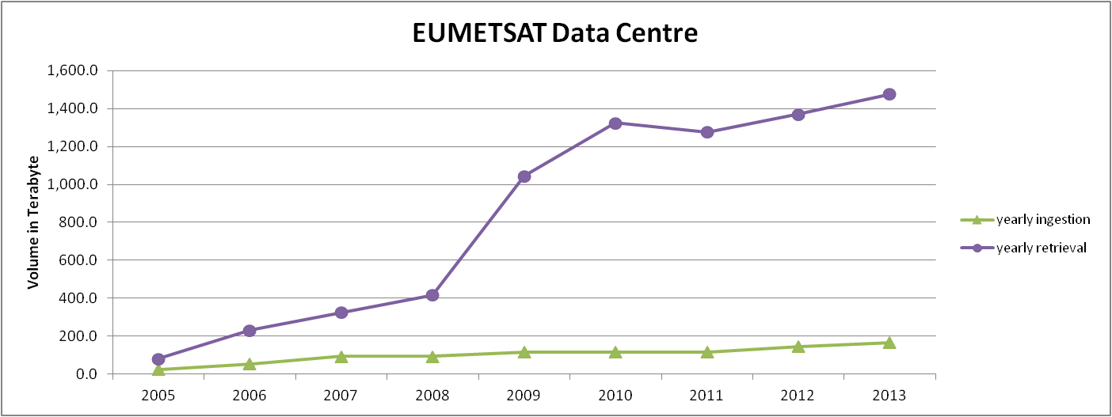
EUMETSAT Long Term Archive
Long-Term Data Preservation in practice since 1995;
Disaster resilient - 3rd Copy
Access via EUMETSAT EO Portal
Ordering is free of charge
Archived data starting 1981
All EUMETSAT Satellite data including reprocessed data
> 1 Petabytes in the archive for MTP, MSG, Metop
Retrieval/Ingestion: 10 to 1

Slide 5
Data Centre – key usage figures (averages: last 2 years)
Currently used Archive Capacity: over 1 Petabyte
Number of archived files: 50,000,000
Ratio Ingestion (in) : Retrieval (out) ca. 1 : 10
Average Retrieval Volume / month: 120 TB
Average Delivery Volume / month 30 TB
Average no. of Items processed / month 700,000
Delivery Online : Media (data volume) 2 : 1
Online : Media (user orders) 19 : 1
Currently registered Users: 3,200
Average active Users ordering / month: 200

Slide 6
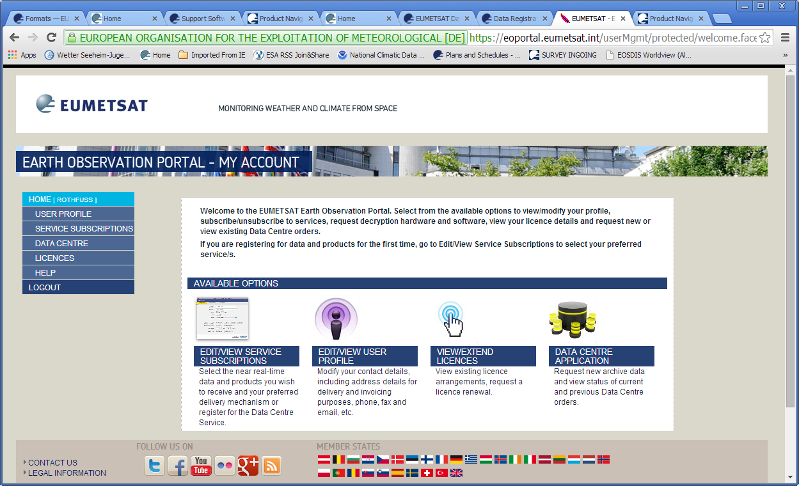
Data Centre – Ordering is integrated in EO-Portal
To order data, start the Online Ordering in the EOP – after registering and subscription to the Data Centre Service.
Info’s on how to order data: http://www.eumetsat.int/website/home/Data/DataDelivery/EUMETSATDataCentre/OrderingFAQandSupport/index.html#ordering

Slide 7
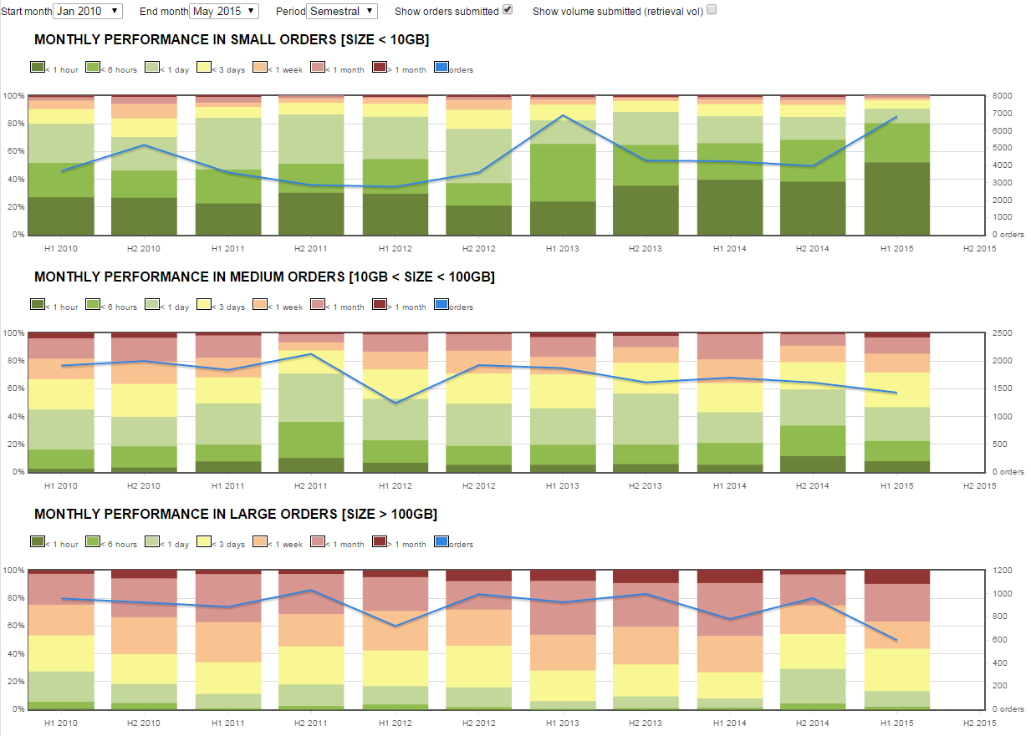
Data Centre Ordering: Order performance estimate

Slide 8
Recent developments in the EUMETSAT Data Centre
Introduction of NetCDF CF as common ordering format (NetCDF in CF convention – to overcome format diversity of Programmes and as a tribute to growing diverse User Community
see details: http://www.eumetsat.int/website/home/Data/DataDelivery/EUMETSATDataCentre/NetCDFFormatforDataCentreProducts/index.html
New light-weight ordering client
  Intuitive, menu driven approach
  Includes also functionality required by S-3 mission
User Ordering Feedback Mechanism
  Can be activated on demand
Digital Object Identifiers (DOI) will be used as persistent identifiers for EUMETSAT‘s Climate Data Records (CDR) to enhance the discoverability and access of CDR's by users.

Slide 9
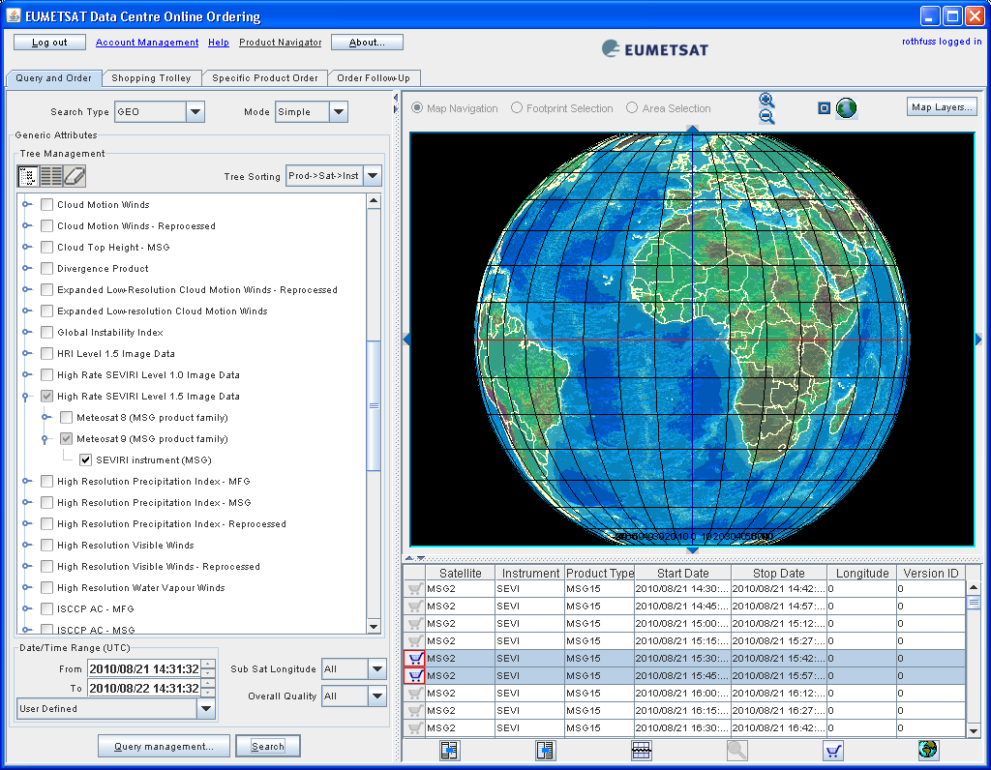
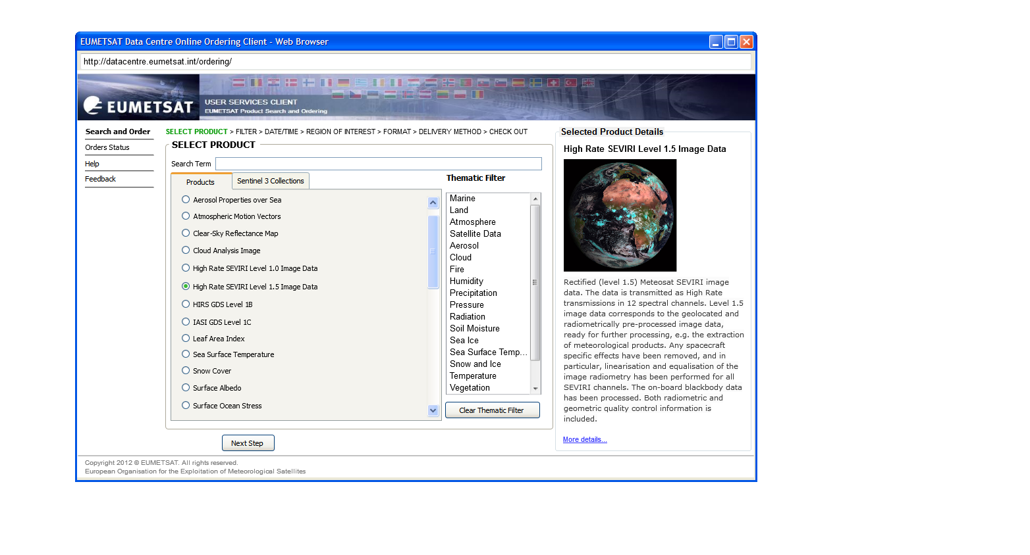
Data Centre Ordering Client Update
A new, web browser based ordering client is under development
Availability to users is planned for QIII 2015
Aim is to simplify the user interface and make it
more intuitive (based on analysis and user feedback;
e.g. 90% of orders are for one product type only)
The current Java-based ordering client will still be
accessible but not further evolved
Improvements summary:
  The new design will guide users through ordering steps
  Enhanced product search
  Estimation of no. of items selected + order size
  Ordering features (e.g. ROI selection,
  enhanced options) only shown if applicable
old
new

Slide 10
Links
EUMETSAT: http://www.eumetsat.int
Helpdesk: ops@eumetsat.int
Data Centre: http://www.eumetsat.int/website/home/Data/DataDelivery/EUMETSATDataCentre/index.html
Data and Products: http://www.eumetsat.int/Home/Main/DataProducts/
EO Portal: http://eoportal.eumetsat.int/
Product Navigator: http://navigator.eumetsat.int/
Overview of Product formats: http://www.eumetsat.int/website/home/Data/Products/Formats/index.html
Product Formats on a per product basis – under Product Navigator : Description Tab:
http://navigator.eumetsat.int/discovery/Start/DirectSearch/DetailResult.do?f(r0)=EO:EUM:DAT:MSG:MSG15-RSS

Slide 11
Annex – New web based Ordering Client / EUMETCAST
Thank you !

Slide 12
New Ordering Client: Data Centre Product Selection
Several product search methods are offered (text, thematic, popularity).
Selecting a product shows product details from the EO-Portal Product Navigator.
Simplified order processing as an order can only be made for 1 type of product.
Control flow of the ordering process
Stepwise approach

Slide 13
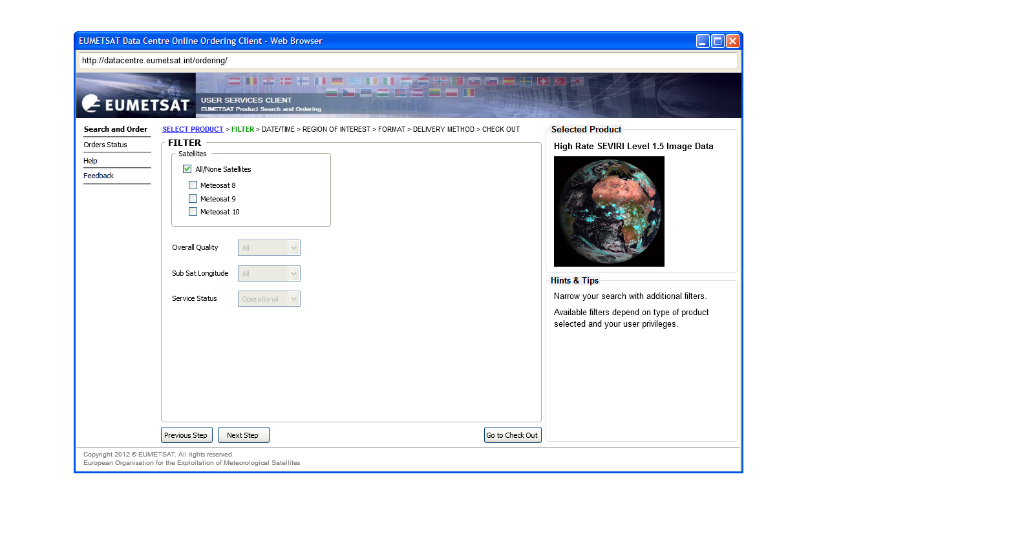
New Ordering Client: Product Filtering
Search can be narrowed using additional filters
Available filters depend on type of product selected and user privileges.
“Go to Check Out” is used to shortcut ordering process by accepting defaults.

Slide 14
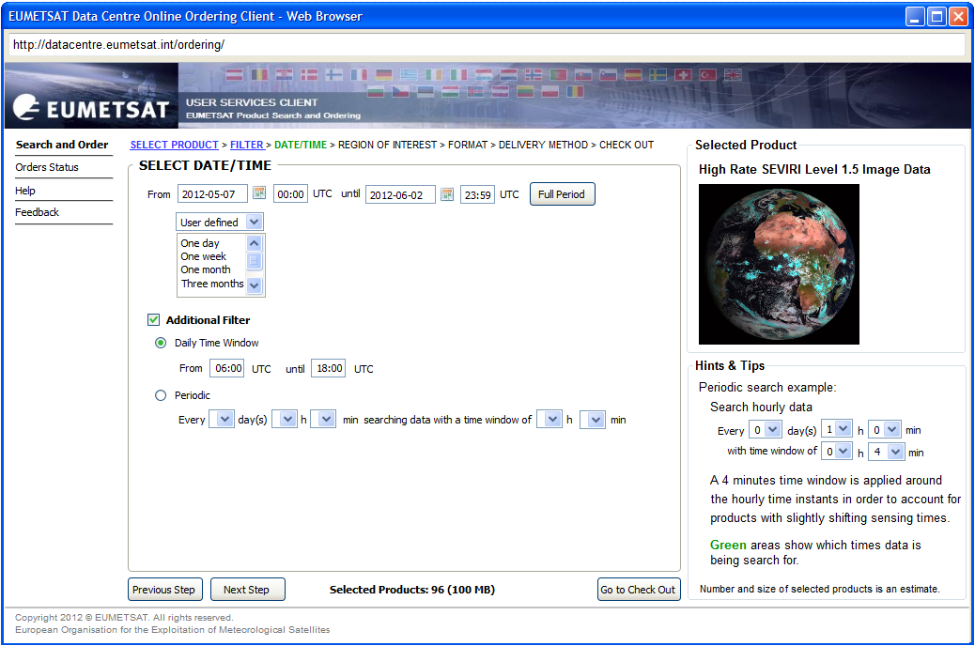
New Ordering Client: Product Data/Time Selection
Filter the product selected using date/time range.
Hints & Tips provide additional usability information based on users’ experiences.
Products estimate for the Order

Slide 15
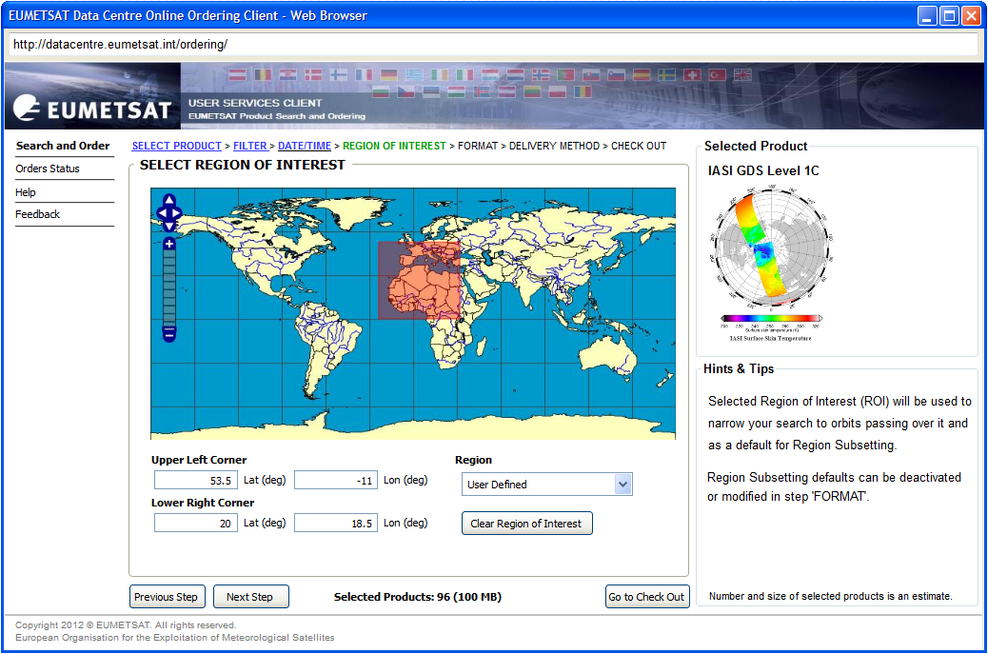
New Ordering Client: Region of Interest (ROI) Search
Filter the product selected depending on its orbits crossing the ROI.
Hints & Tips provide additional usability information based on users’ experiences.

Slide 16
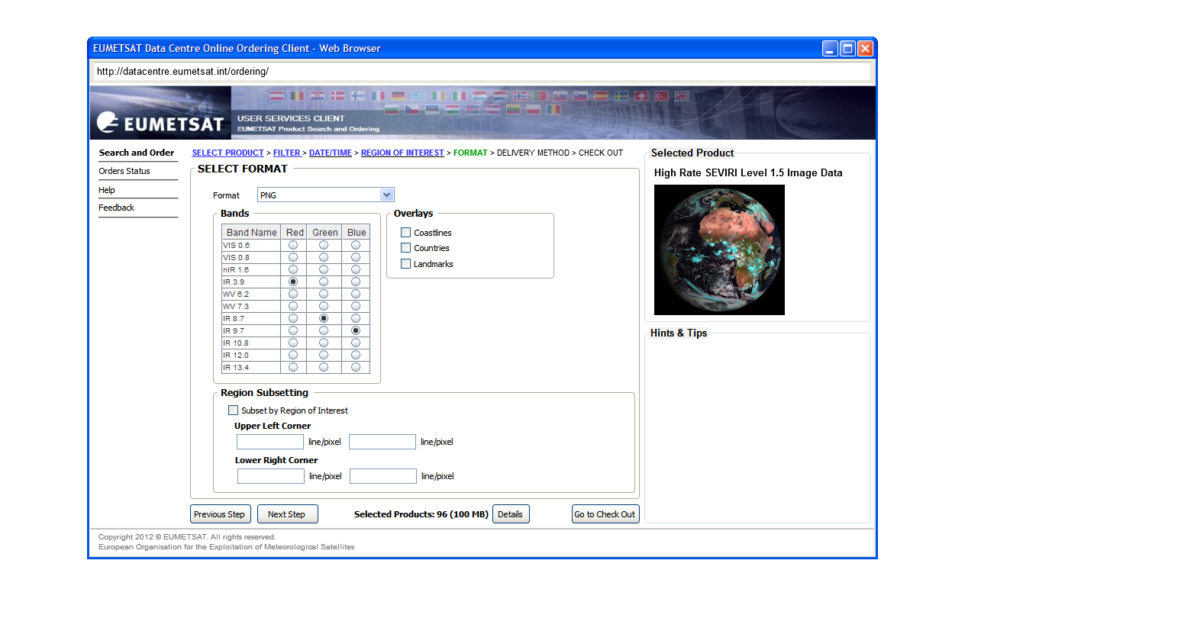
New Ordering Client: Delivery Format Selection
Users selects the delivery format and ROI subsetting for all products in the order
“Details” - Examine the details of the products in this order, as sufficient information has been provided to return the ‘filtered’ products from the Data Centre Catalogue (see next slide)
Format dependent

Slide 17
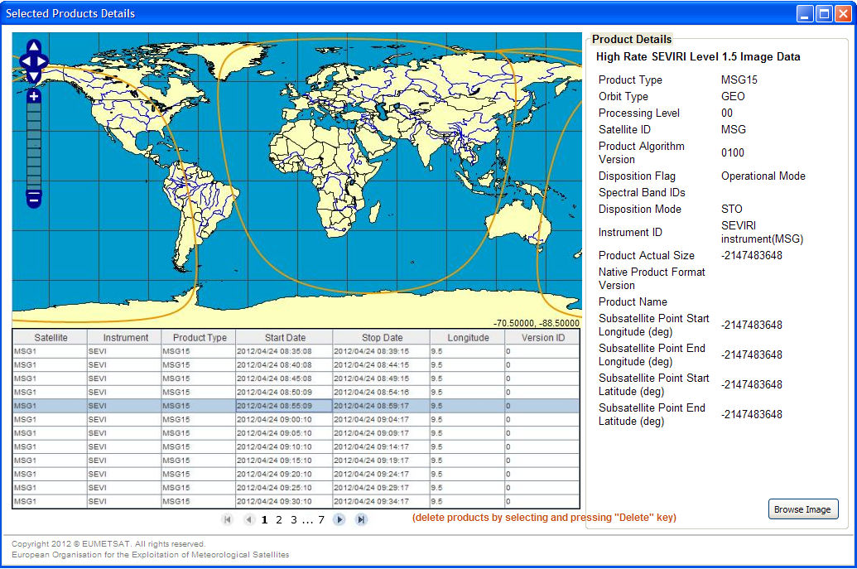
New Ordering Client: Products’ Details for this Order
Users should use this page to ensure their filtering criteria contains the products expected.
Products in the order are split into lists
Users can easily browse these lists and select / delete any product in them.
Metadata for the selected product is displayed. A browse Image can be displayed

Slide 18
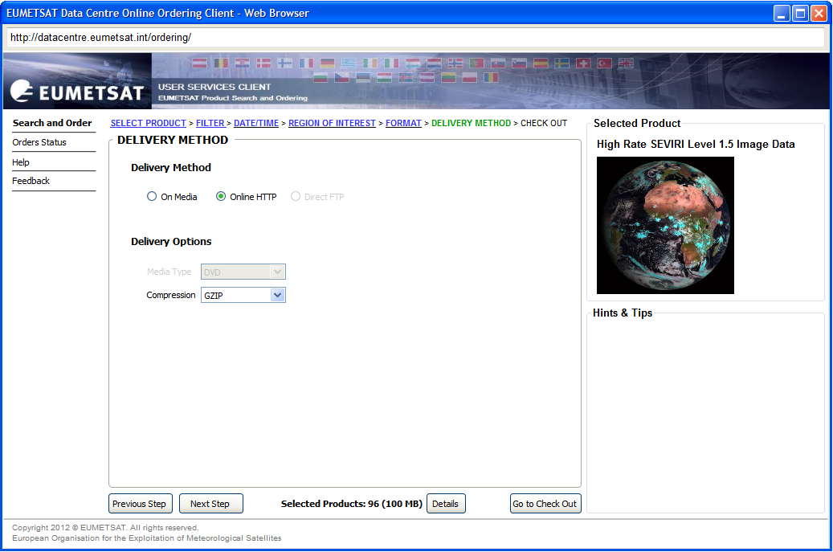
New Ordering Client: Delivery Method Selection
Users select the preferred delivery method and whether data compression should be applied to their order.

Slide 19
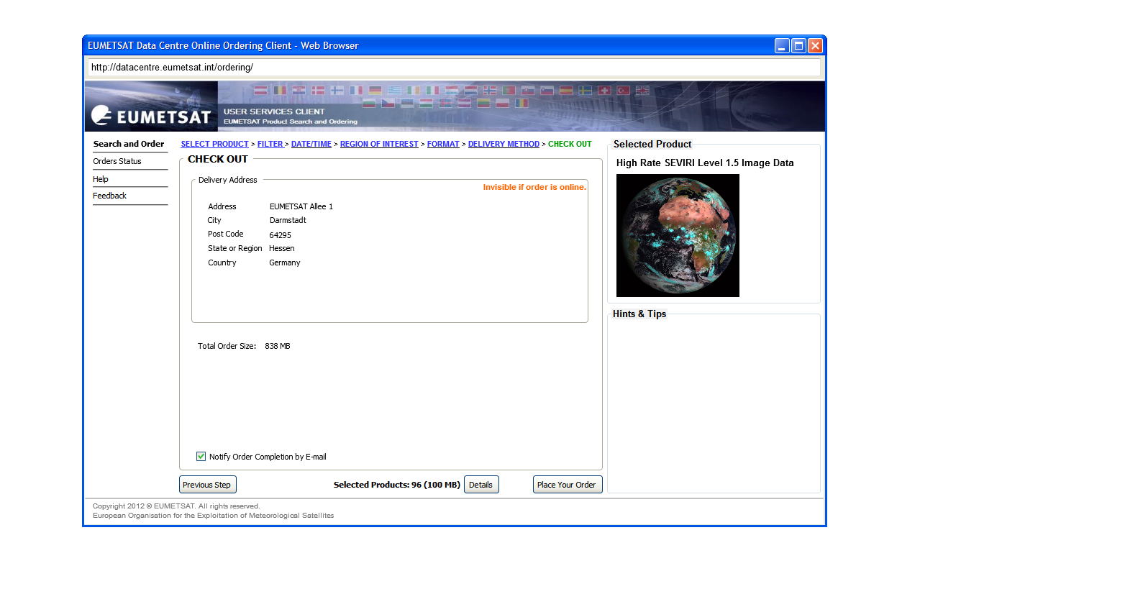
New Ordering Client: Place the Data Centre Order
To submit the order for processing, select the “Place Your Order” button

Slide 20
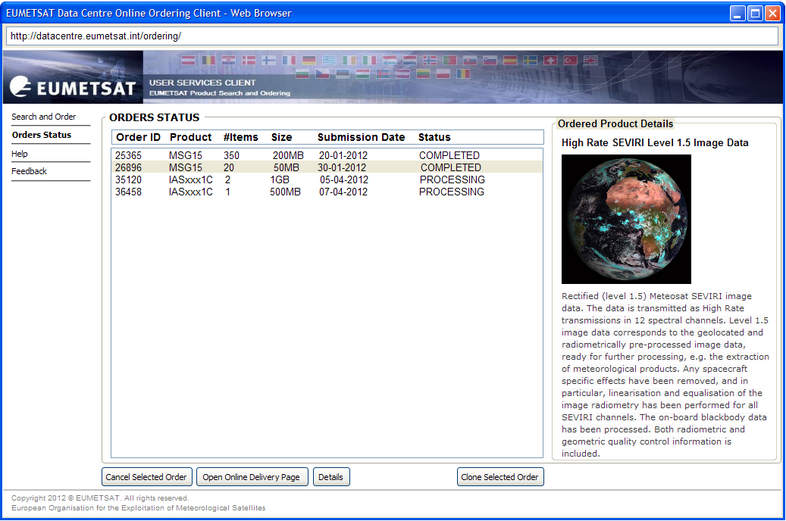
New Ordering Client: Order Status
Users can track the status of their order(s) from this page.
It also provides the order history for the user
For convenience, previous orders can be cloned for the creation of new ‘similar’ orders.

Slide 21
End

